Slide 1
Question 1
Force = mass X __________________________.

Slide 2
Question 2
An object at rest stays at rest until an unbalanced __________ acts upon it.

Slide 3
Question 3
--------→ ←--------
125 N 600 N
Predict how this force diagram will move.

Slide 4
Question 4
Which scientist wrote the first laws about motion?

Slide 5
Question 5
What does the symbol N represent about motion?

Slide 6
Question 6
Which simple machine would cut or split an object?

Slide 7
Question 7
---→ ←---
600 N 600 N
Is this force diagram balanced or unbalanced?

Slide 8
Question 8
If an object was pushed with a force of 500 N, and it moves 0 meters, how much work was done?

Slide 9
Question 9
Which simple machines could lift an object off the ground?

Slide 10
Question 10
Which simple machine uses a fulcrum?

Slide 11
Question 11
---→ ---→
250 N 250 N
What is the net force of this diagram?

Slide 12
Question 12
What is velocity?

Slide 13
Question 13
Which type of simple machine allows you to roll an object uphill?

Slide 14
Question 14
Draw a force diagram that is unbalanced and has a net force of 300 newtons.

Slide 15
Question 15
Which type of simple machine allows you to pry something open?

Slide 16
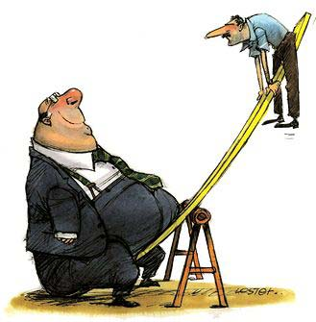
Question 16
Is this system balanced or unbalanced?
What is the net force of this system?
300 N
100 N

Slide 17
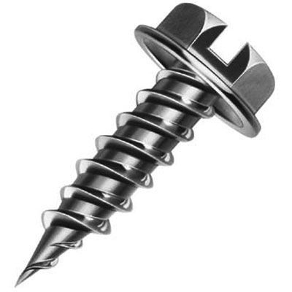
Question 17
What simple machine is wrapped around a screw?

Slide 18
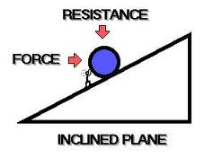
Question 18
What are two examples of an inclined plane?

Slide 19
Question 19
Is this force diagram balanced or unbalanced?
Explain.
---→
250 N
---→ ←--------
250 N 425 N
---→
250 N

Slide 20
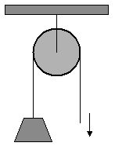
Question 20
Does this pulley give you any mechanical advantage?

Slide 21
Question 21
Work is when you ______ an object.

Slide 22
Question 22
How does a speed graph look if an object is moving at a constant speed?

Slide 23
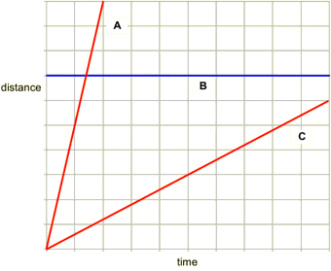
Question 23
Which speed line is moving the fastest?
Which speed line is not moving?

Slide 24
Question 24
What is potential energy?

Slide 25
Question 25
What are two examples of kinetic energy?

Slide 26
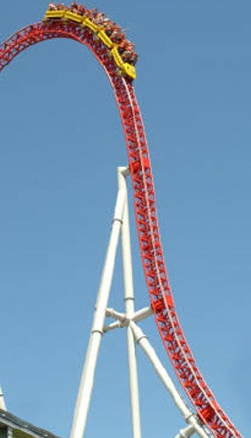
Question 26
Where is the most potential energy?
Where is the most kinetic energy?

Slide 27
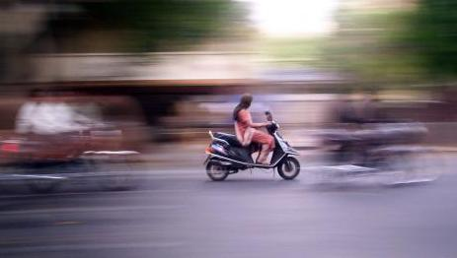
Question 27
What is the average speed of a person riding on a scooter for 100 km in 4 hours?

Slide 28
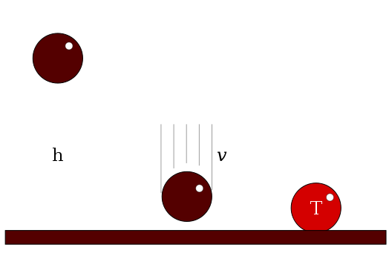
Question 28
Where does the ball have the most potential energy?
Where does the ball have the most kinetic energy?

